Slide 1


Computational and Experimental Design Single Cell Analysis Program (SCAP) Workshop
September 23-27, 2024
Kilifi, Kenya

Slide 2
Computational track
Monday
Module 1 - pre-processing
Module 2 - quality control, normalization
Project time
Tuesday
Module 3 - cell subsets, differential expression, cell annotation
Module 4 - batch correction, integration
Project time
Wednesday
Module 5 – immune repertoires
Project time
Thursday
Project time
Friday
Project presentations

Slide 3
Module 3 – cell annotation
3a. Embeddings
3b. Clustering
3c. Differential expression
3d. Reference datasets and automated annotation

Slide 4
Determining cell type, state, and function
Quality control
Normalization
Feature selection
Dimensional reduction
Cell-cell distances
Unsupervised clustering
Kiselev C. at al. (2019) Nature Reviews Genetics. 20: 273-282.

Slide 5

Single-cell RNA-Seq analysis: feature selection
gene 2
Cells are in 20,000 dimensional space (one dimension for each gene), but hard to visualize!
gene 1
gene 3
Genes with highly variable expression contain biological signal related to cell states.
Many genes are lowly detected or noisy measurements.
We typically select 2,000-5,000 variable genes.
Notes:
Next we carry out feature selection, In this cartoon, cells are in 3D space with each cell localized based on its expression of genes 1,2,3. In reality cells are in 20K dimensional space (genes in human genome) but this is hard to visualize, and it is very difficult to cluster cells in higher-dimensional space. To reduce the dimensionality of the data, we only use those genes whose expression levels are highly variable across individual cells. The intuition is that a gene that has the same expression across all cells will not distinguish different T cell states, while genes that are high in one state and low in another state are informative. This is the feature selection. We typically select 2000-5000 most highly variable genes.

Slide 6
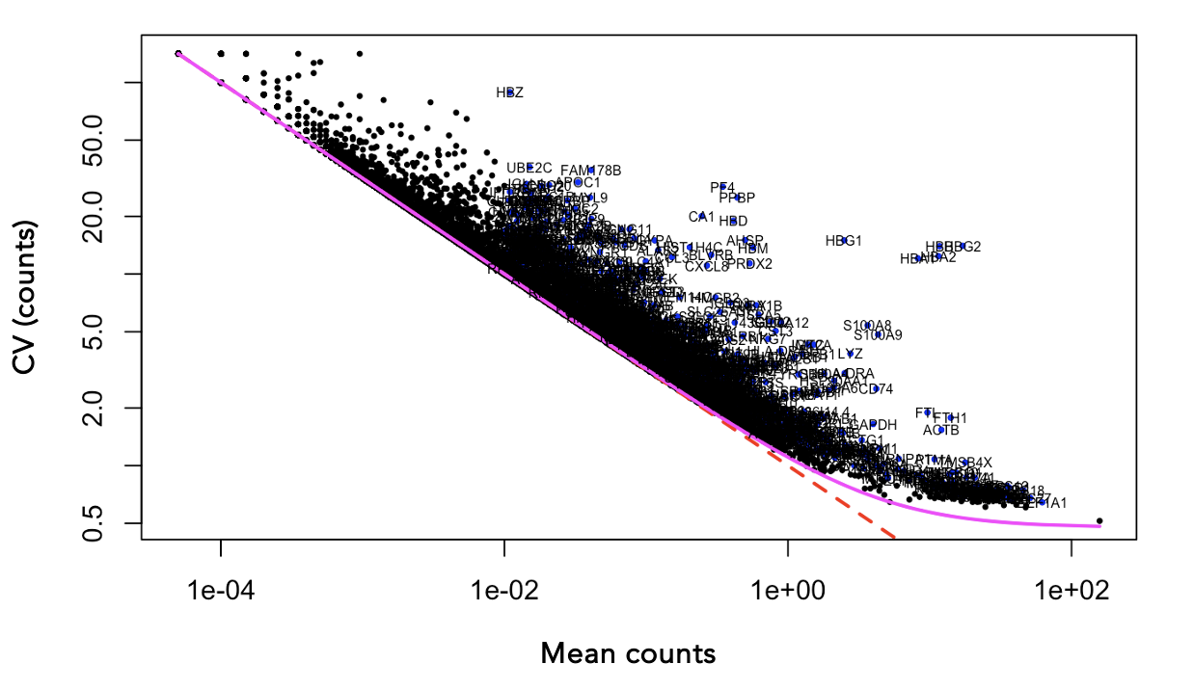
Single-cell RNA-Seq analysis: feature selection
Find genes (features) that are outliers in a plot of mean of gene expression vs variance of gene expression

Slide 7
Determining cell type, state, and function
Quality control
Normalization
Feature selection
Dimensional reduction
Cell-cell distances
Unsupervised clustering
Kiselev C. at al. (2019) Nature Reviews Genetics. 20: 273-282.

Slide 8
Dimensionality reduction
Cells are in ~20,000 dimensional space
many genes are lowly detected / noisy measurements
genes are not independent of one another! rather they operate in coregulatory modules
curse of dimensionality
Principle component analysis moves us from describing cells with 20,000 gene expression values to 10-100 principal component scores

Slide 9
Dimensionality reduction
One approach to simplification is to assume that the data of interest lies within lower-dimensional space. If the data of interest is of low enough dimension, the data can be visualised in the low-dimensional space.
Common Techniques
Principal Component Analysis (PCA)
Independent Component Analysis (ICA)
Multidimensional Scaling (MDS)
Non-negative Matrix Factorization (NMF)
Probabilistic Modeling (e.g. Latent Dirichlet Allocation - LDA)

Slide 10
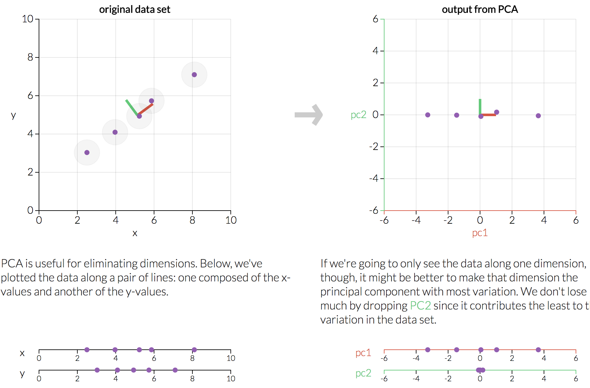
Dimensionality reduction
http://setosa.io/ev/principal-component-analysis/

Slide 11

Dimensionality reduction
PCA is a dimensionality reduction method that transforms a set of features into a set of linearly uncorrelated variables called principal components
The first principal component contains the most variance, and each component after contains as much variance while still being orthogonal to other components
https://stats.stackexchange.com/questions/2691/making-sense-of-principal-component-analysis-eigenvectors-eigenvalues

Slide 12
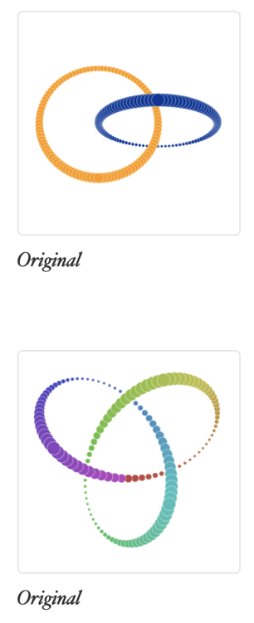
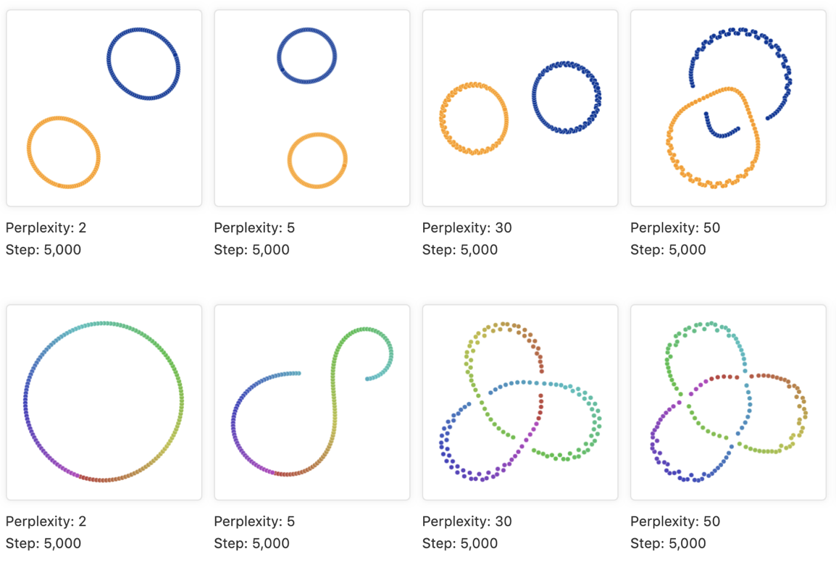
Representing local neighborhoods
High dimension manifold
Low dimension representation
Place cells with similar local neighborhoods in high-dimension space together in low-dimension space.
t-SNE and UMAP are popular visualizations.
https://distill.pub/2016/misread-tsne
https://pair-code.github.io/understanding-umap/
Notes:
Local accuracy vs global accuracy in representation

Slide 13
Module 3 – cell annotation
3a. Embeddings.
3b. Clustering.
3c. Differential expression.
3d. Reference datasets and automated annotation.

Slide 14
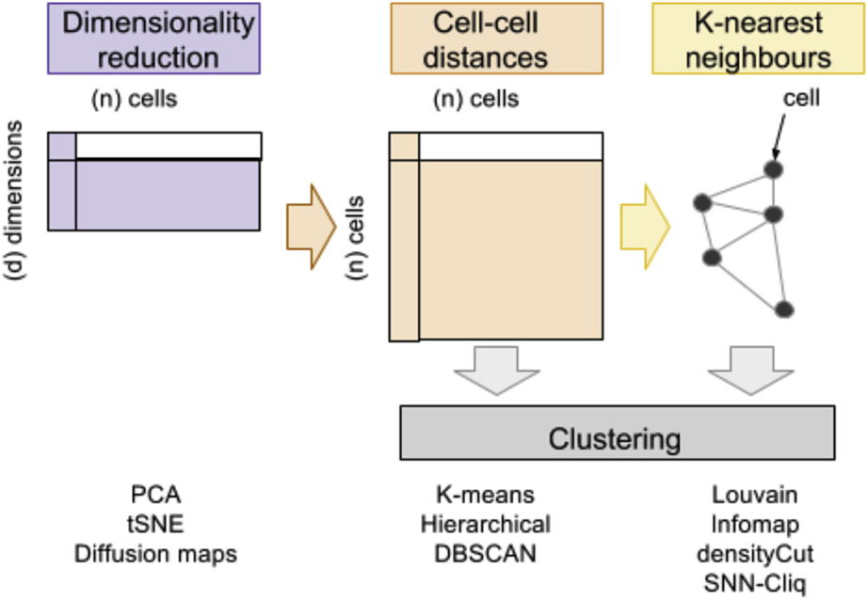
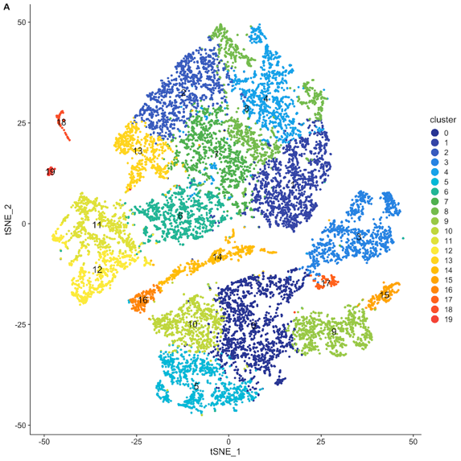
Clustering in KNN graphs
Andrews, Tallulah S. at al. (2017) Molecular aspects of medicine.

Slide 15
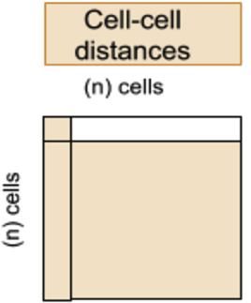

KNN graph

Slide 16
KNN graph
1

Slide 17
KNN graph
1
2

Slide 18
KNN graph
1
3
2

Slide 19
KNN graph
4
1
3
2

Slide 20
KNN graph
4
1
3
2
4
1
3
2

Slide 21
KNN graph

Slide 22

Clustering in KNN graph

Slide 23
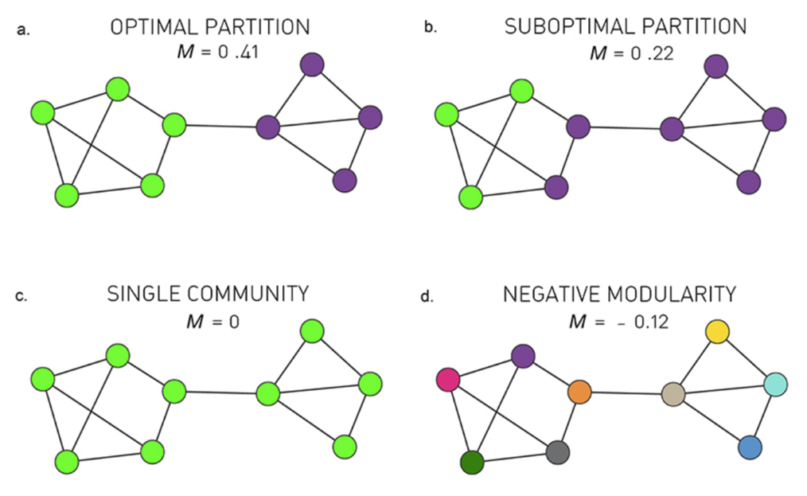
Clustering in KNN graph
Graph-based clustering is based on community detection.
Many different algorithms for community detection:
Louvain (heuristic), Infomap, Walktrap
Most of them are based on modularity maximization

Slide 24
Module 3 – cell annotation
3a. Embeddings.
3b. Clustering.
3c. Differential expression.
3d. Reference datasets and automated annotation.

Slide 25
Comparing gene expression distributions
In scRNA-Seq we often do not have a defined set of experimental conditions.
Instead, we can perform pairwise comparisons of gene expression, between pairs of cell clusters, using some of the following tests:
Wilcoxon rank sum test
Student’s t-test
Wald test in a generalized linear models – depend on a choice of distribution: poisson or negative binomial underlying negative binomial distribution. Use only for UMI-based datasets
Others…

Slide 26
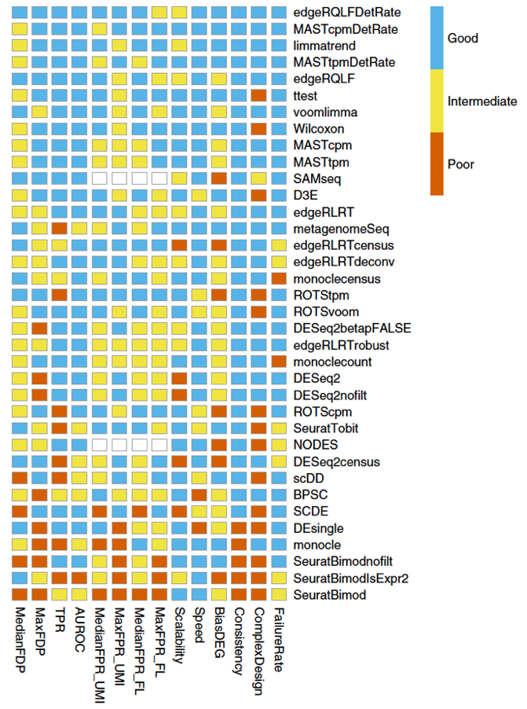
Differential expression analyses
There are many ways to test for differential expression!
It is difficult to establish a ground truth for differential expression in scRNA-seq data. Therefore, benchmarking is difficult.
Soneson C. at al. (2018) Nature Methods. 15: 255-261.

Slide 27
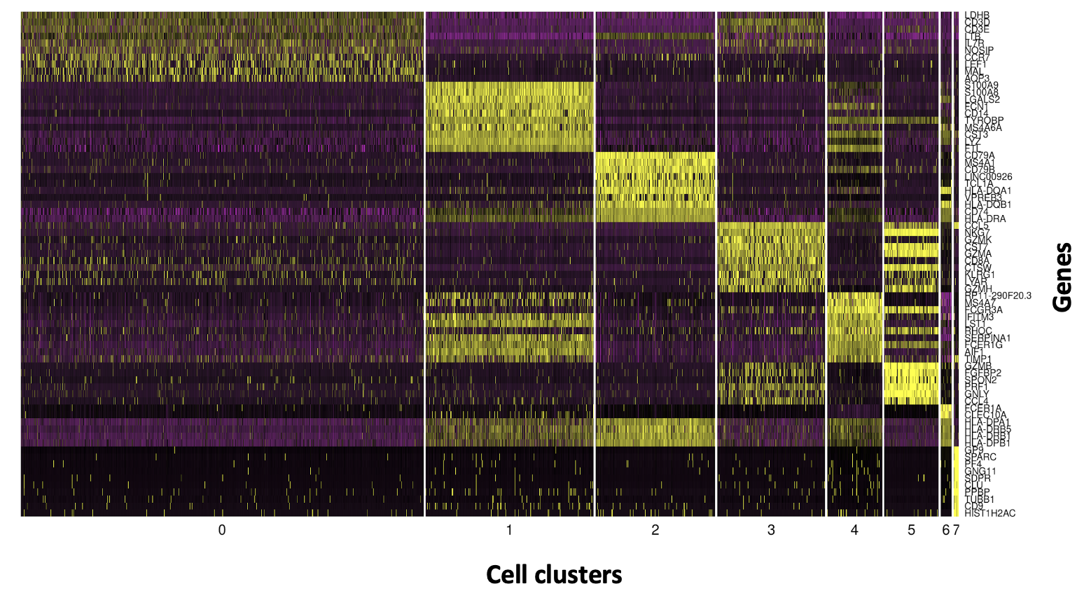
Differential expression analyses

Slide 28
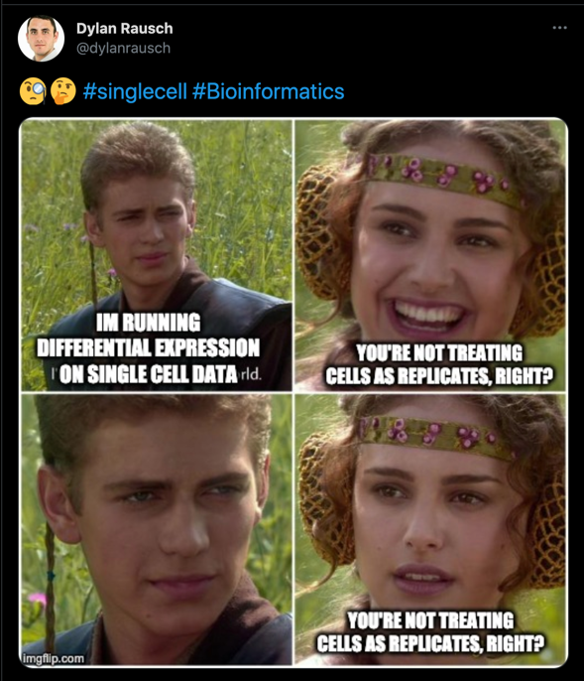
Differentially expressed genes across biological conditions
When detecting gene differentially expressed across different biological conditions (e.g. case vs control, treated vs untreated, etc…), what is the replicate? A single cell? A sample?
Treating a single cell as a replicate will lead to false discoveries so treat p-values with care. Consider using pseudobulk models or mixed effect models when comparing samples across conditions as an alternative.
Crowell, Helena L., et al. "Muscat detects subpopulation-specific state transitions from multi-sample multi-condition single-cell transcriptomics data." Nature communications (2020).
Squair, Jordan W., et al. "Confronting false discoveries in single-cell differential expression." Nature communications (2021).
https://www.nxn.se/valent/2019/2/15/handling-confounded-samples-for-differential-expression-in-scrna-seq-experiments

Slide 29
Module 3 – cell annotation
3a. Embeddings.
3b. Clustering.
3c. Differential expression.
3d. Reference datasets and automated annotation.

Slide 30
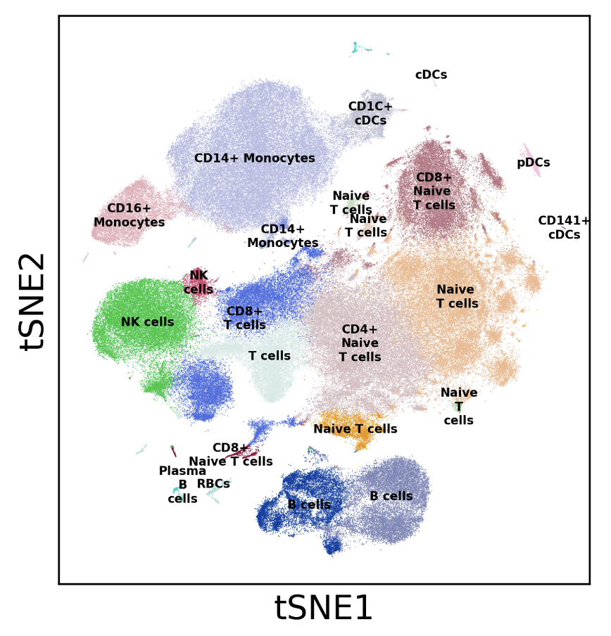
Single-cell RNA-Seq analysis: Cell state annotation
500K immune cells collected from healthy humans.
Immune cells are colored by their cluster identity and visualized in a tSNE embedding.
Cell types are identified by inspecting genes differentially expressed in one cluster relative to other clusters.

Slide 31
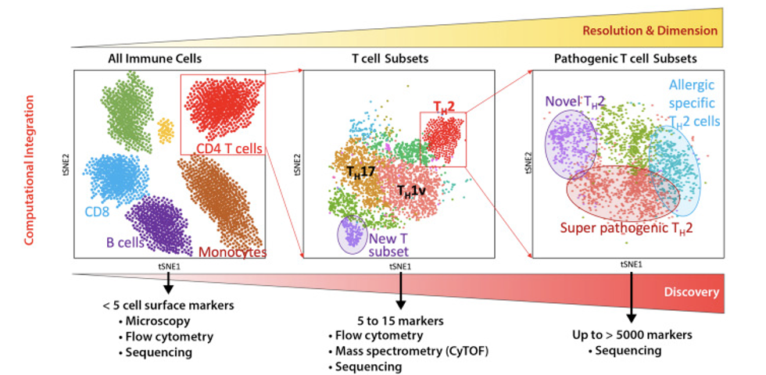
Add biology to your data!
Annotating cells in single-cell gene expression data is a challenge
-What is a cell type?
Gene expression is not discrete but mostly a continuum
Gene expression ≠ cellular function
-Resolution
Subsets
Phenotypes
Differentiation
Seumois G, Vijayanand P 2019 . J Allergy Clin Immunol.

Slide 32
Approach 1: De novo cluster annotation
Three main approaches to assigning clusters
Annotating based on known marker genes
Annotating on differential gene expression
Annotating on previously reported module scoring
Edge cases
Doublets
Low-quality cells
Host-pathogen annotations
Clustering accuracy
Over-clustering
Under-clustering
Iterative clustering

Slide 33
Annotating based on known marker genes
Requires understanding of expected cell types and their markers
Biological expertise here is critical
Many protein and RNA markers overlap
However, not all protein markers translate well into RNA space
Experience with cell types in sample and scRNA-seq will help identify which protein markers do or do not translate to RNA space
Most useful for identifying coarse cell types and some cell states, but difficult to annotate pathological cell states in disease

Slide 34
Annotating on differential gene expression
Begin with one-against-all differential gene expression
Easier to annotate based on upregulated rather than downregulated genes
Known marker genes that are highly expressed should show up here
May not depending on differential gene expression cutoffs
Top 20 to 30 genes should give an indication of the cell states as well as cell type
Ex. Inflammatory, anti-viral, low-quality, etc.

Slide 35
Annotating on differential gene expression (cont’d)
This is an iterative process
You should not expect to be able to confidently identify all your cell clusters on your first pass
There will likely be clusters that are very similar to each other
Run differential gene expression between those similar clusters ONLY to figure out what’s different between them
If differential gene expression doesn’t make sense biologically, combine clusters into one
Continue to iterate and re-check work as you go

Slide 36
Annotating on previously reported module scoring
Supplementary tables will usually list differential gene expression used for assigning clusters in other studies
Use these to your advantage
Great for checking work
Make sure species and system are correct
Technology used may influence results
These basic techniques should not be used in a vacuum—they build on each other to convince you that you have annotated your clusters correctly

Slide 37
Approach 2: Databases and Reference atlases
Marker genes and databases
Literature
Tissue and protein DB
Single-cell atlases
Automated tools
Correlation-based
Supervised classification

Slide 38

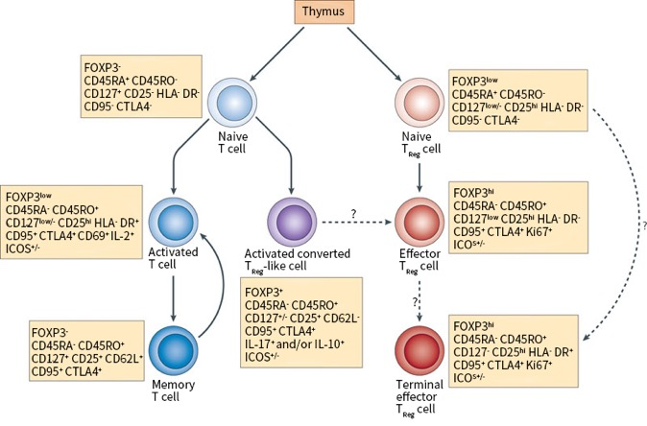
Approach 2: Marker genes and databases
Literature!
Single-cell RNA-seq is a new field but cell types are not!
Book knowledge is important, know your model!
Rely on experts and collaborators

Slide 39
Approach 2: Marker genes and databases
Tissue and protein DB
Protein cell atlas - > https://www.proteinatlas.org/
Immunological Genome Project - > https://www.immgen.org/
GTEx (Genotype-Tissue Expression) -> https://gtexportal.org/home/

Slide 40
Approach 2: Marker genes and databases
Other organisms
Mouse https://www.emouseatlas.org
Fly https://flybase.org/
C. elegans https://www.wormatlas.org/
Zebra fish https://bio-atlas.psu.edu/zf/
NCBI
https://www.ncbi.nlm.nih.gov/
The European Bioinformatics Institute (EMBL- EBI)
https://www.ebi.ac.uk/services

Slide 41
Approach 2: Single-cell atlases
Single-cell DB for manual annotation
Meaning you have a set of genes and search for them in these DB
Human cell atlas (HCA) https://www.ebi.ac.uk/humancellatlas/project-catalogue/
Tabula murris (Mouse atlas)
Broad institute Single-cell portal https://singlecell.broadinstitute.org/
PanglaoDB https://panglaodb.se/
CellMarker http://biocc.hrbmu.edu.cn/CellMarker/index.jsp

Slide 42
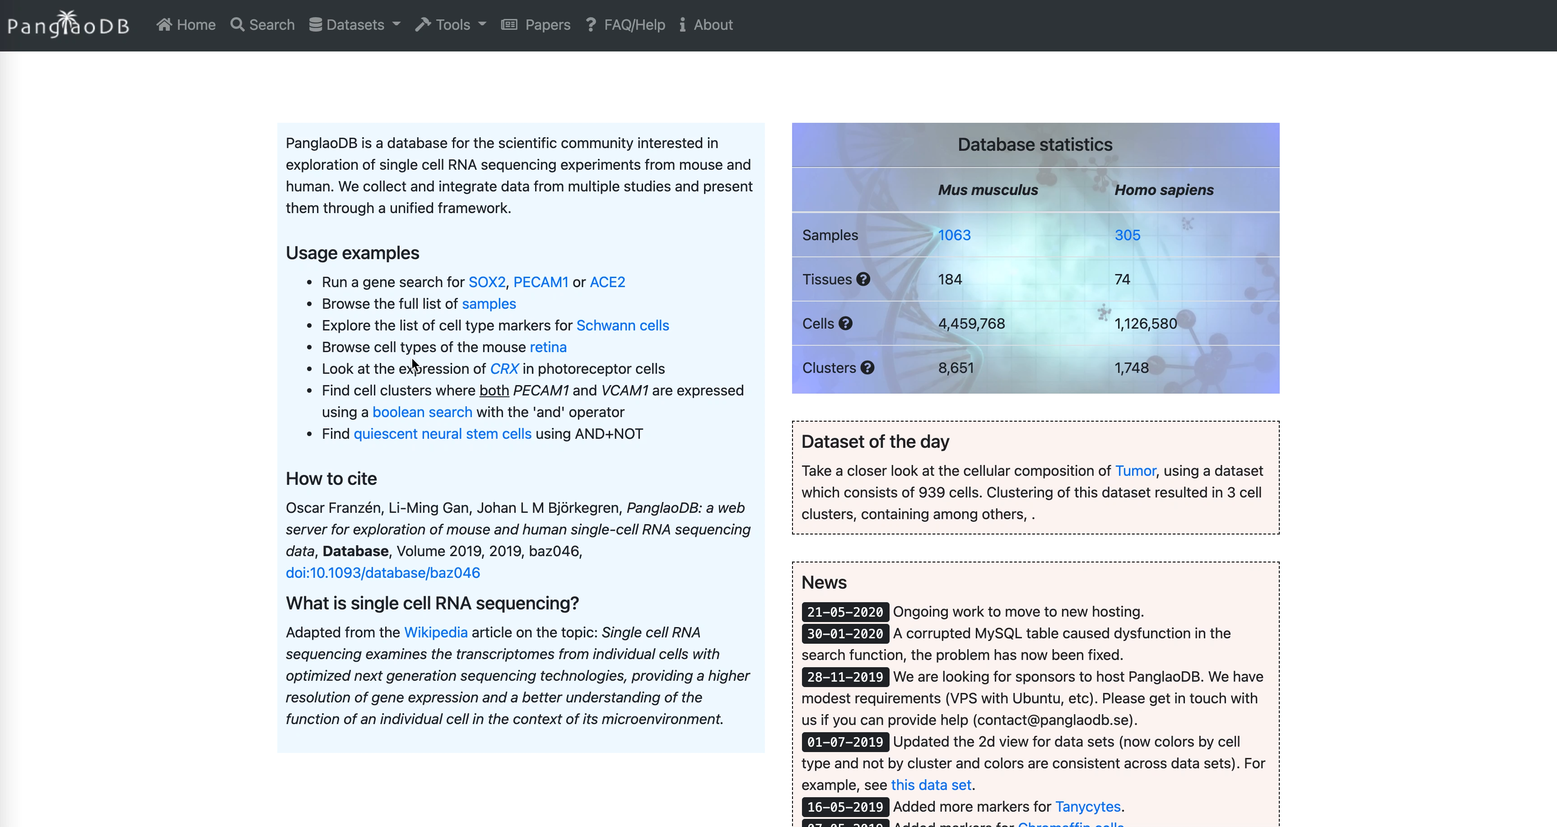
Approach 2: Single-cell atlases
Single-cell DB for manual annotation
PanglaoDB https://panglaodb.se/

Slide 43
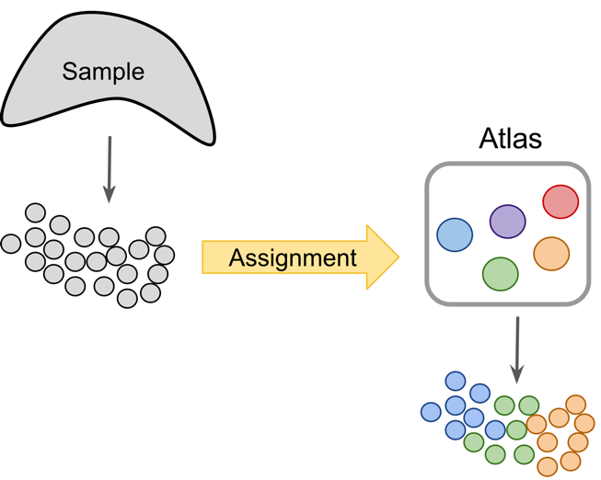
Approach 2: Automated tools
Project cells or clusters from a new sample onto a reference (Cell Atlas or previous study) to identify cells with novel/unknown identity ----> Cell type like BLAST method
IMPORTANT: A reference cell type information is needed
Can be done intra-species
Different-omics!
Different approaches
Correlation-based
Supervised classification
https://www.singlecellcourse.org/

Slide 44
Approach 2: Automated tools
Approach | Tool name | Language | Computational approach
Correlation-based | scmap-cluster | R, web app | Cosine, Spearman, Pearson
 | scmap-cell | R, web app | Cosine distance based kNN
 | SingleR | R | Spearman
 | CHETAH | R, Shiny app | Spearman + confidence
 | scMatch | Python | Spearman, Pearson
 | ClustifyR | R | Spearman, Pearson, Kendall, cosine
 | CIPR | R, Shiny app | Dot product, Spearman, Pearson
Supervised classification-based | CaSTLe | R | XGBoost classifier
 | Moana | Python | kNN-smoothing + SVM
 | LAmbDA | Python | Multiple ML techniques
 | superCT | Web app | Artificial Neural Network
 | SingleCellNet | R | Random Forest
 | Garnett | R | Elastic net regression
 | scPred | R | SVM
 | ACTINN | Python | Artificial Neural Network
 | OnClass | Python | kNN and Bilinear Neural Network
 | scClassify | R, Shiny app | Weighted kNN classifier
 | scArches | Python | Autoencoder
Pasquini et al, 2021, Computational and Structural Biotechnology Journal

Slide 45
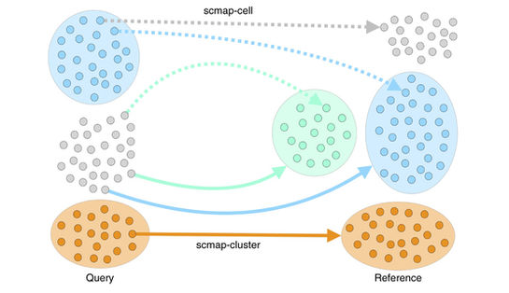

Approach 2: Automated tools
The search can be done by cluster or by cell , in each cluster/cell by its centroid (a vector of the median value of the expression of each gene) and measure the similarity between c and each cluster centroid or cell in the refence is calculated and ranked
Pasquini et al, 2021, Computational and Structural Biotechnology Journal

Slide 46
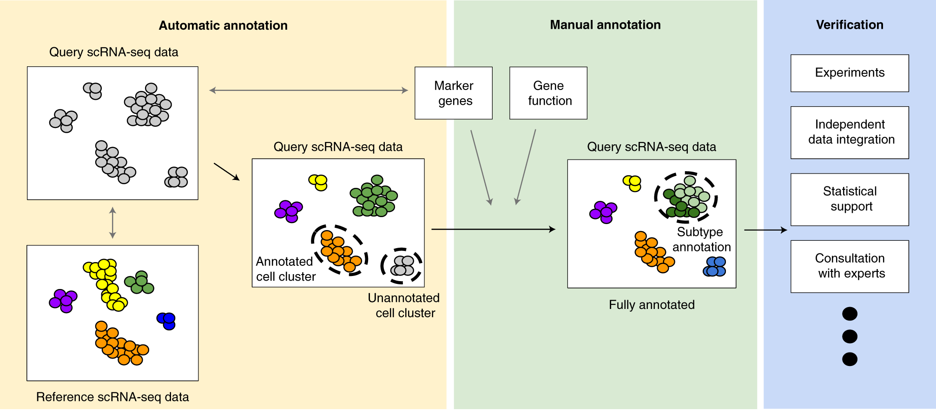
Overview of automated + manual annotation workflow
An ideal cluster/cell type annotation process is composed of three major steps: automatic cell annotation, manual cell annotation and verification
Clarke, Z.A., Andrews, T.S., Atif, J. et al Nat Protoc 16, 2749–2764 (2021).

Slide 47
Extra slides

Slide 48

Example – identifying low quality cell states
366.650 cells from human colon mucosa

Slide 49
Example – identifying low quality cell states

Slide 50
Example: annotate clusters

Slide 51
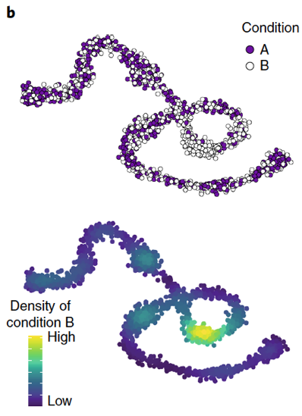
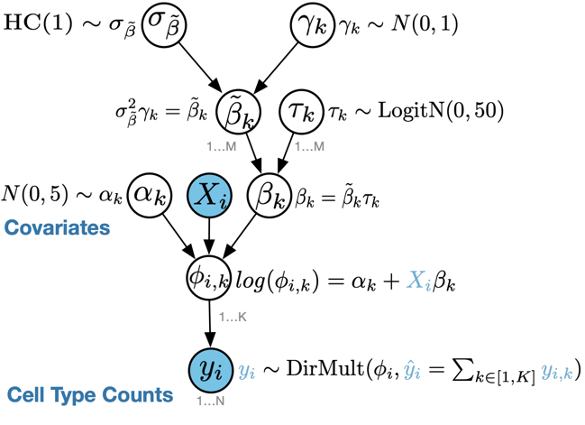
Testing for significant changes in cell type abundance across biological conditions
Assume we have 3 cell types (A, B, C) in a treated and untreated sample. If the frequency of cell type A increases in the treated sample due to the treatment, what will happen to the frequencies of cell types B and C?
The compositional nature of cell type abundance data means the abundances of cell type A, cell type B, and cell type C are not independent of one other. Their frequencies must always sum to 1.
scCODA
Milo
Büttner et al., Nature Communications. (2021).
Dann et al., Nature Biotech. (2022).

Slide 52
Host-pathogen annotations
ScRNA-seq will capture poly-adenylated pathogen reads for intra-cellular pathogens
Required alignment against custom, combined host-pathogen genome
Pathogen RNA != intra-cellular pathogen presence
Especially in low quantities, pathogen RNA may be from ambient background contamination
Intra-cellular pathogen RNA != active infection
Phagocytes sample their environment and other cells continuously and may readily capture pathogen RNA

Slide 53
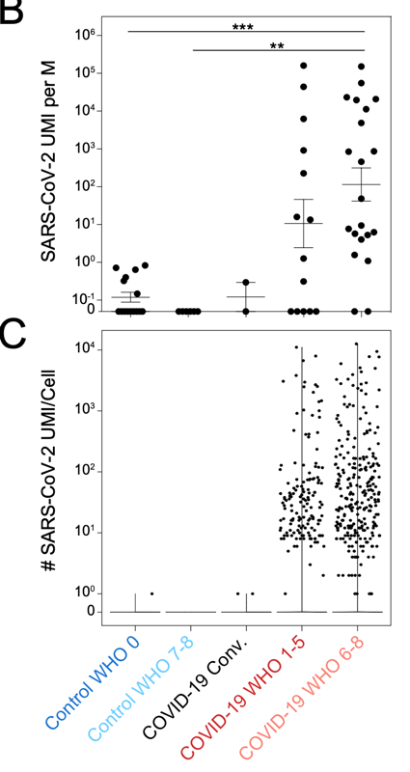
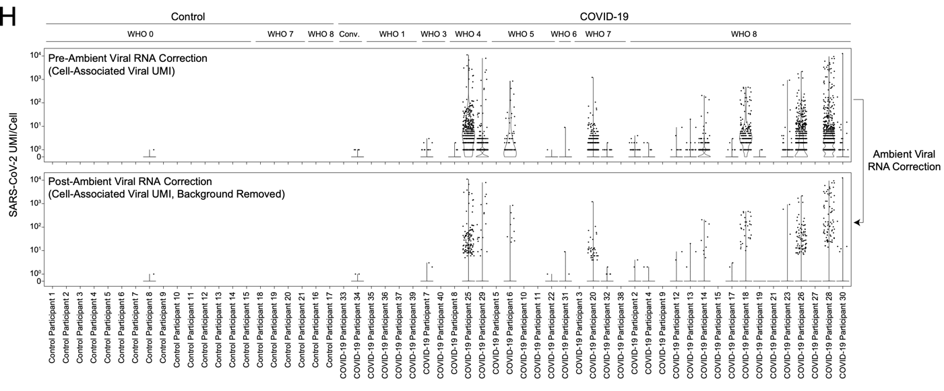
Host-pathogen annotations (cont’d): A COVID-19 example
Fleming et al., bioRxiv, 2019; Kotliar et al., Cell, 2020; Ziegler et al., Cell, 2021.
Notes:
We first estimated the ambient RNA background in our dataset, as well as the percentage of background reads that are of viral origin, using tools that were developed by some of our colleagues here at the Broad, to establish a threshold over which we’re confident that the viral reads associated with a cell barcode actually came from within the cell, and not from free-floating viral RNA that happened to be encapsulated during processing. After correction, and as expected, we recovered the vast majority of viral reads in COVID-positive individuals, with rare spurious alignment in our control cohort.

Slide 54
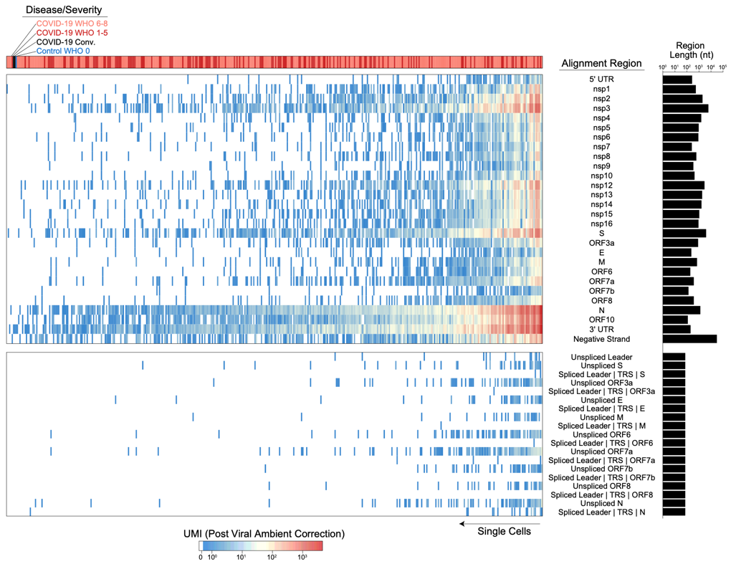
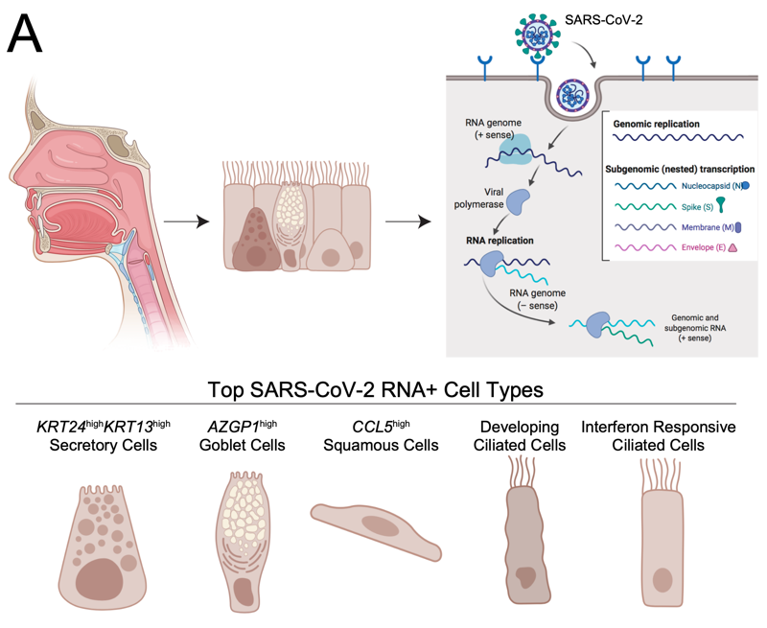
Host-pathogen annotations (cont’d): A COVID-19 example
Ziegler et al., Cell, 2021.
Notes:
We mapped out reads to various regions in the CoV-2 genome
And you can see that the vast majority of reads are biased toward the 3’ end of the genome, which is expected with 3’ priming in our single-cell protocols – so nucleocapsid, open reading frame 10, and the 3’ untranslated region.
Multiple subgenomic mRNAs are also created during the coronavirus replication process – These spliced mRNAs encode a translational regulatory sequence from the 5’ end of the genome spliced onto a body translation regulatory sequence. And if we happen to read across this region, then we can detect whether a viral RNA is spliced – and the thought that we had is that if a cell’s associated with spliced mRNA, it’s more likely that there’s active ongoing viral infection and replication within this specific cell
So we aggregated together multiple viral metrics that we could measure from our data for any single cell – the total number of viral RNAs, the diversity of viral RNAs tiling across the genome, and presence of spliced RNA, to call cells that are likely actively infected – and once again these span the various epithelial lineages that express the required entry receptors for CoV-2.

Slide 55
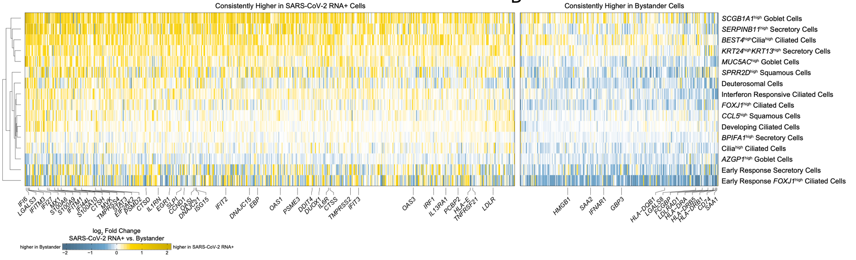
Host-pathogen annotations (cont’d): A COVID-19 example
Ziegler et al., Cell, 2021.
Notes:
We can then compare the transcriptional programs of viral RNA+ and bystander cells of the same cell type and phenotype, and we see a lot of conservation across our clusters. Viral RNA+ cells are generally
Enriched for canonical interferon-response genes,
Inflammatory genes like IL1RN and S100A9,
And viral entry cofactors such as CTSH or TMPRSS2. And on the other side, bystander cells are
Interestingly enriched for type I interferon receptor,
As well as many of the class II MHC molecules.

